Slide 1

CSc 102 - Project
Zelalem S. Shibeshi
Together we can change the world

Slide 2
Fundamentals of Android App Development
Android Programming Languages
Android apps are written in Java (or Kotin), and use XML extensively.
Android App Components
Activities
Services
Broadcast Receivers:
Content Provider:
Notes:
Engineering as defined by G. F. C. Rogers is ‘the practice of organising the design and construction of any artifice which transforms the physical world around us to meet some recognised need’ (Rogers, 1983).
A software development process is the practice of organising the design and construction of software and its deployment in context.

Slide 3
App Components
Activities – represents a single screen with UI – So, an app with a visible user interface is implemented via an activity (when we run an app the activity is started)
Services – apps that need to persist for a long time (e.g. network monitoring or update checking)
Content providers – (to manage access to persisted data, such as contacts on a phone)
Broadcast receivers – apps to process a specific element of data or respond to an event, such as receiving a text message.
Notes:
Engineering as defined by G. F. C. Rogers is ‘the practice of organising the design and construction of any artifice which transforms the physical world around us to meet some recognised need’ (Rogers, 1983).
A software development process is the practice of organising the design and construction of software and its deployment in context.

Slide 4
Activities and fragments
An Activity represents a single screen or window in an Android app.
It involves managing the user interface and interactions with the screen (i.e it is a User Interface that contains activities).
We can have one or more depending upon the App.
At least one activity is always present which is known as MainActivity. It serves as the entry point
Each Activity is a subclass of the android.app.Activity class.
Fragments are reusable UI components within an Activity.
Notes:
Engineering as defined by G. F. C. Rogers is ‘the practice of organising the design and construction of any artifice which transforms the physical world around us to meet some recognised need’ (Rogers, 1983).
A software development process is the practice of organising the design and construction of software and its deployment in context.

Slide 5
User Interaction and Lifecycle Management
Each activity is responsible for handling user interactions specific to its screen. It can include displaying information, taking user input, showing lists or grids of items, and responding to user-initiated actions.
An Activity goes through various states during its lifecycle.
Activities have their own lifecycle, including methods like onCreate, onStart, onResume, etc., which allow you to manage the state of the activity and respond to lifecycle events.
Notes:
Engineering as defined by G. F. C. Rogers is ‘the practice of organising the design and construction of any artifice which transforms the physical world around us to meet some recognised need’ (Rogers, 1983).
A software development process is the practice of organising the design and construction of software and its deployment in context.

Slide 6
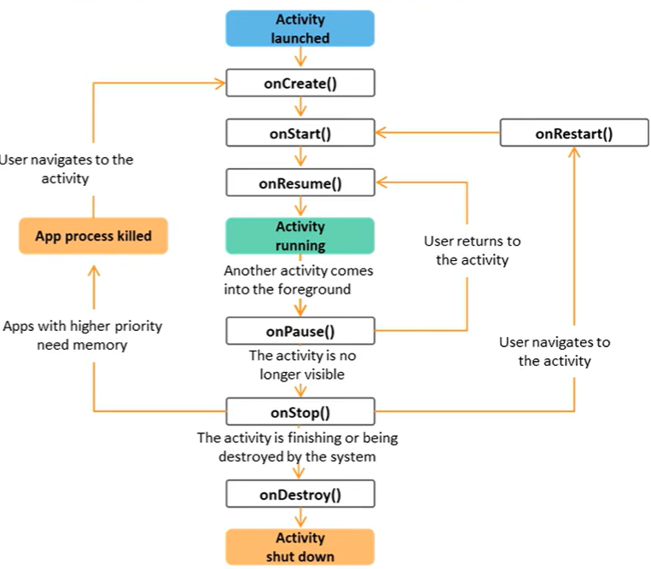

Slide 7
UI Development (Design)
Layouts and Views:
A View is a fundamental building block of the user interface. It represents a UI element that the user can interact with or see e.g TextView, Button).
A Layout defines the structure and arrangement of multiple View elements in an Activity.
A layout is an XML file that specifies where and how the View elements are positioned and styled.
Activities coordinate and manage the Views (UI elements) that make up the user interface. That is, the Activity manages interactions with the Views.
Notes:
Engineering as defined by G. F. C. Rogers is ‘the practice of organising the design and construction of any artifice which transforms the physical world around us to meet some recognised need’ (Rogers, 1983).
A software development process is the practice of organising the design and construction of software and its deployment in context.

Slide 8
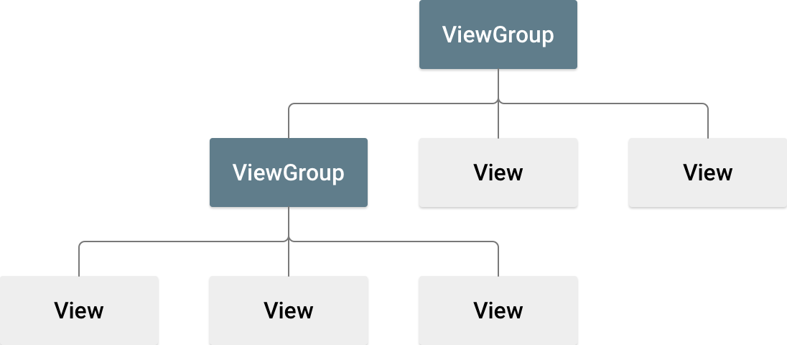
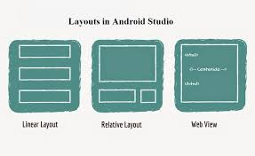
UI Development (Design)
Layouts
A layout is a type of ViewGroup, which is a container that holds and arranges child views (like buttons, text fields, and images) on the screen.
Android provides several layout types that allow you to arrange these child views in various ways.
We have different layout types (e.g., LinearLayout, ConstraintLayout, RelativeLayout, etc)
Notes:
Engineering as defined by G. F. C. Rogers is ‘the practice of organising the design and construction of any artifice which transforms the physical world around us to meet some recognised need’ (Rogers, 1983).
A software development process is the practice of organising the design and construction of software and its deployment in context.

Slide 9
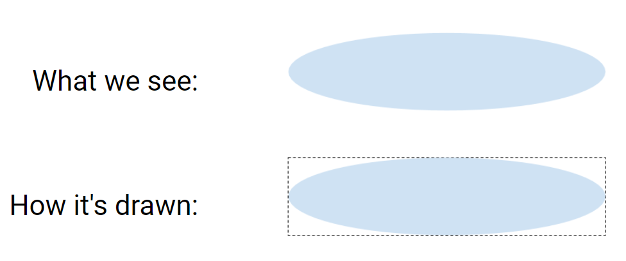
Drawing region
Views are drawn differently than how we see them
Notes:
Engineering as defined by G. F. C. Rogers is ‘the practice of organising the design and construction of any artifice which transforms the physical world around us to meet some recognised need’ (Rogers, 1983).
A software development process is the practice of organising the design and construction of software and its deployment in context.

Slide 10
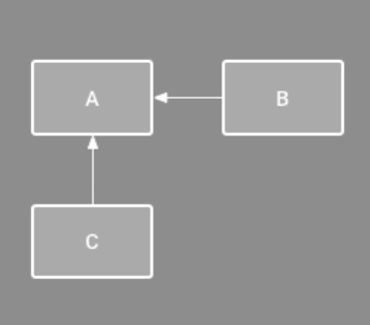
What is a constraint?
A constraint is a restriction or limitation on the properties of a View that the layout attempts to respect
The above picture indicates the constraints that Android should adhere to when placing the views. So view C should be placed under A and B to the right of A
Notes:
Engineering as defined by G. F. C. Rogers is ‘the practice of organising the design and construction of any artifice which transforms the physical world around us to meet some recognised need’ (Rogers, 1983).
A software development process is the practice of organising the design and construction of software and its deployment in context.

Slide 11
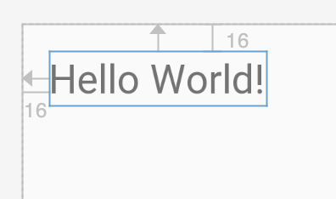
What is a constraint?
Can set up a constraint relative to the parent container
Example attributes on a TextView:
app:layout_constraintTop_toTopOf="parent"
app:layout_constraintLeft_toLeftOf="parent"
Notes:
Engineering as defined by G. F. C. Rogers is ‘the practice of organising the design and construction of any artifice which transforms the physical world around us to meet some recognised need’ (Rogers, 1983).
A software development process is the practice of organising the design and construction of software and its deployment in context.

Slide 12
Android App Development Environment
Android Studio - an Integrated Development Environment (IDE) based on IntelliJ
Android SDK (Software Development Kit) for developing and running Android apps (includes a debugger, libraries, and a device emulator). It comes with android studio when you install it.
We run our app on our Android mobile device by enabling USB Debugging or using an emulator (on a virtual device).
Notes:
Engineering as defined by G. F. C. Rogers is ‘the practice of organising the design and construction of any artifice which transforms the physical world around us to meet some recognised need’ (Rogers, 1983).
A software development process is the practice of organising the design and construction of software and its deployment in context.

Slide 13
Creating the First Android Project
A project in Android Studio contains everything that defines your workspace for an app, from source code and assets to test code and build configurations.
When you create a project, you choose the type of project you want to create for the selected device type.
Once a project is created, Android Studio creates the necessary folder structure for all your files.
You also need to specify the package for your project, and select the Minimum API level you want your app to support
Notes:
Engineering as defined by G. F. C. Rogers is ‘the practice of organising the design and construction of any artifice which transforms the physical world around us to meet some recognised need’ (Rogers, 1983).
A software development process is the practice of organising the design and construction of software and its deployment in context.

Slide 14
Android Project Files
Within each Android app module, files are shown in the following groups:
src – contains the source code and resources for the module. Subdirectories include:
Main – the main source set for the module
java – contains the java (kotlin) source code files
res – contains all non-code resources, such as UI, strings and images. Key subdirectories include: layout, drawable, values
manifests – contains the AndroidManifest.xml file.
Notes:
Engineering as defined by G. F. C. Rogers is ‘the practice of organising the design and construction of any artifice which transforms the physical world around us to meet some recognised need’ (Rogers, 1983).
A software development process is the practice of organising the design and construction of software and its deployment in context.

Slide 15
Android Virtual Devices (AVDs):
AVDs are specialized virtual devices designed for running Android apps and emulating Android devices.
Android apps are developed for a wide range of real Android devices, each with different hardware specifications, screen sizes, resolutions, and capabilities.
When you create an AVD, you're essentially simulating a specific Android device configuration (specifying the device's screen size, resolution, amount of RAM, CPU architecture).
Notes:
Engineering as defined by G. F. C. Rogers is ‘the practice of organising the design and construction of any artifice which transforms the physical world around us to meet some recognised need’ (Rogers, 1983).
A software development process is the practice of organising the design and construction of software and its deployment in context.

Slide 16
AndroidManfest (Android Application Descriptor File)
An Android application is deployed to a device along with a file named AndroidManifest.xml.
The manifest file provides essential information about the app to the Android system, which the system must have before it can run any of the app's code..
It describes essential information about the app, including package name, permissions, components (activities, services, receivers), and more.
It's a crucial file for the Android system to understand and manage your app.
Notes:
Engineering as defined by G. F. C. Rogers is ‘the practice of organising the design and construction of any artifice which transforms the physical world around us to meet some recognised need’ (Rogers, 1983).
A software development process is the practice of organising the design and construction of software and its deployment in context.

Slide 17
AndroidManfest (Android Application Descriptor File)
An example of an Android manifest file
<application>
<activity android:name=".MainActivity">
<intent-filter>
<action android:name="android.intent.action.MAIN" />
<category android:name="android.intent.category.LAUNCHER" />
</intent-filter>
</activity>
</application>
Notes:
Engineering as defined by G. F. C. Rogers is ‘the practice of organising the design and construction of any artifice which transforms the physical world around us to meet some recognised need’ (Rogers, 1983).
A software development process is the practice of organising the design and construction of software and its deployment in context.

